Slide 1


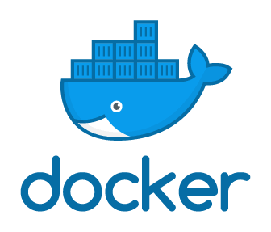
DevOps

Slide 2
AGENDA
Docker
Need of Docker Compose
Docker Compose
Advantages

Slide 3
WHAT IS DOCKER?
Docker is a tool which is used by developer and operation teams to create and automate the deployment of application in lightweight containers so that applications can work efficiently in different environments.

Slide 4
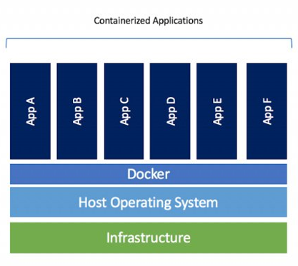
CONTD…
Container is a software package that consists of all the dependencies required to run an application.

Slide 5
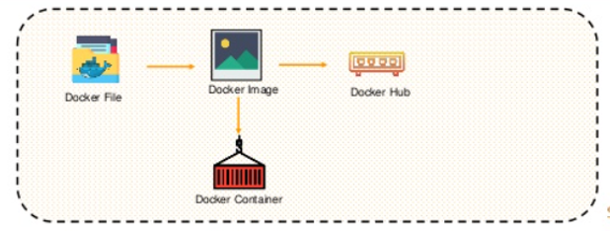
CONTD…
With Docker image, an individual can run the project code in order to create docker containers.
When a Docker image is built, it is uploaded by a user in Docker Hub.

Slide 6
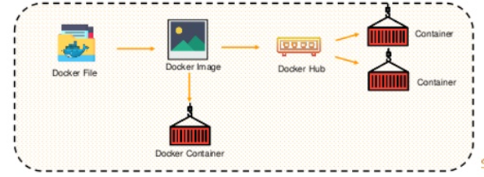
CONTD..
From the Docker Hub, users can pull any Docker Image and build new containers.

Slide 7
NEED OF DOCKER Compose
If a user wants to use two containers in a single service. Then what to do?
Suppose you have more than one container in Docker like a webserver and a database running in separate containers. What to do?

Slide 8
NEED OF DOCKER Compose
Building, running and connecting the containers from separate Dockerfiles is difficult and can take a lot of time.
But with Docker Compose, it is possible to easily run more than one container in a single service.

Slide 9

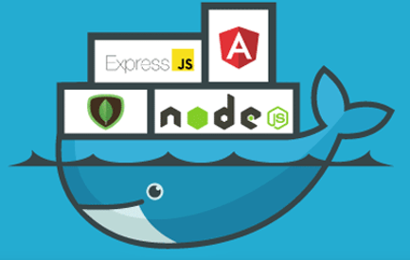
DOCKER Compose

Slide 10
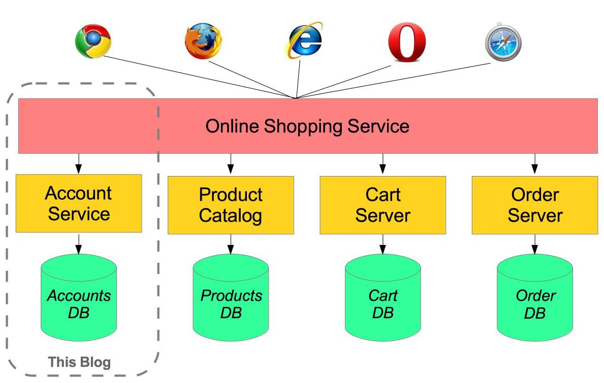
DOCKER Compose

Slide 11
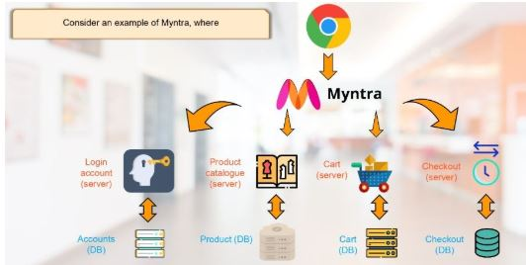
DOCKER Compose

Slide 12
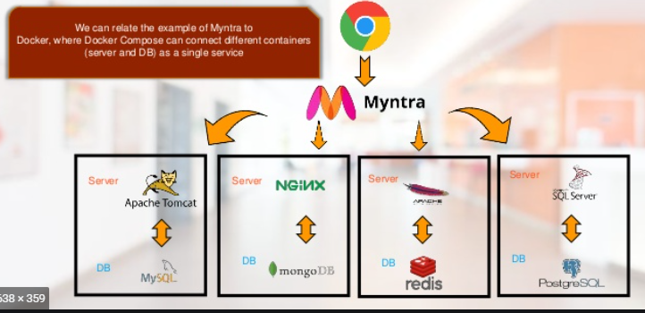
DOCKER Compose

Slide 13
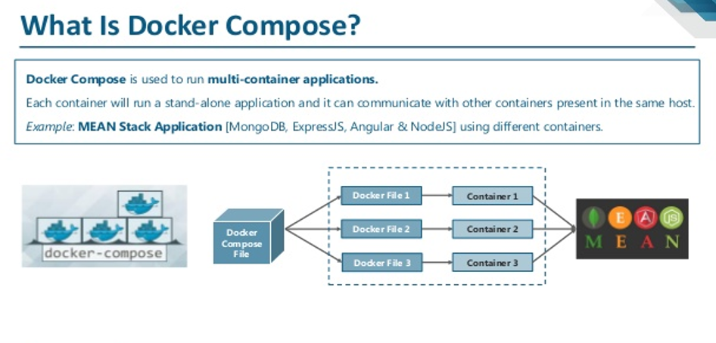
DOCKER Compose

Slide 14
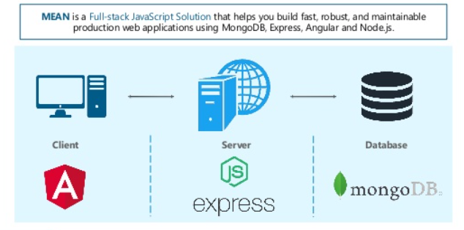
MEAN STACK APPLICATION

Slide 15
difference between Docker compose and Docker
The docker cli is used when managing individual containers on a docker engine.
It is the client command line to access the docker daemon api.
The docker-compose cli can be used to manage a multi-container application.

Slide 16
Should I use Docker compose?
You can set the desired amount of containers counts, their builds, and storage designs, and then with a single set of commands you can build, run and configure all the containers.
Docker Compose is great for development, testing, and staging environments, as well as continuous integration workflows.

Slide 17
BENEFITS OF DOCKER COMPOSE
Single host deployment - This means you can run everything on a single piece of hardware
Quick and easy configuration - Due to YAML scripts.
High productivity - Docker Compose reduces the time it takes to perform tasks.
Security - All the containers are isolated from each other, reducing the threat landscape

Slide 18
BASIC COMMANDS
https://www.katacoda.com/courses/docker/11
Check the version of Docker Compose
docker-compose –v
docker-compose version
docker-compose –version
Start all services: docker-compose up
Stop all services: docker-compose down
Run Docker Compose file: docker-compose up -d
List the entire process: docker ps

Slide 19
What is Docker registry?
In the long term, the Docker registry is the location for taking Docker images. The registry can be the neighbourhood repository of a customer or an open repository just like the Docker Hub, such that various customers can work together to develop their application. Indeed, containers can be traded or shared with other organizations in a comparable partnership by moving them to the Docker Hub. Docker Hub is one of the Docker's own cloud repositories such as Git-hub.

Slide 20
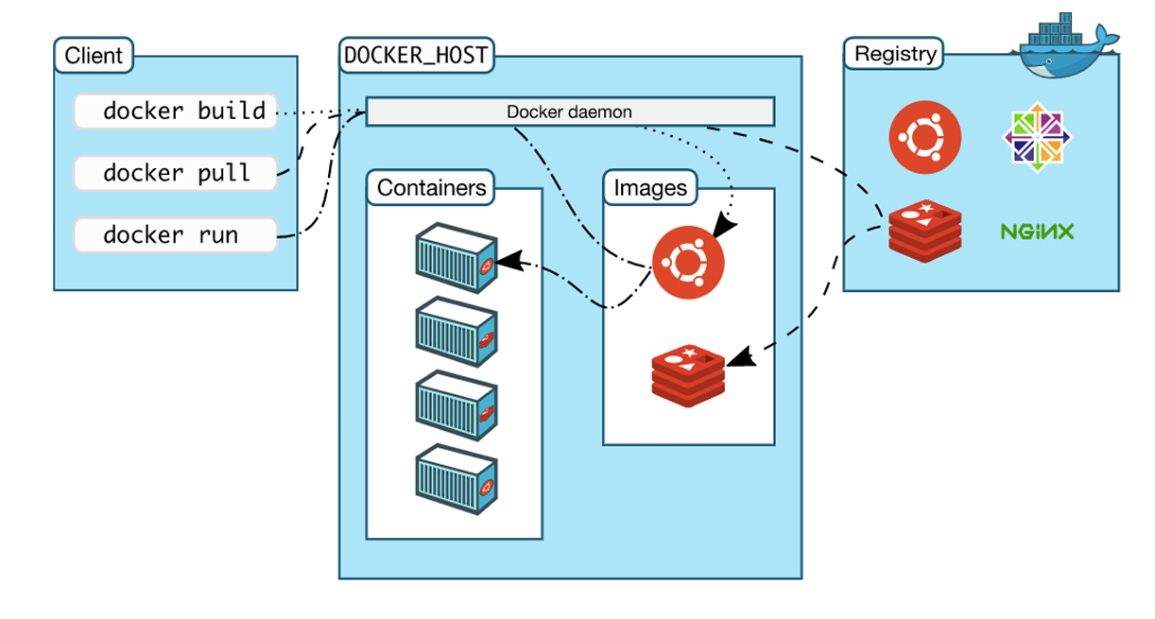
Docker Architecture

Slide 21


